Slide 1
Parallelogram in Quadrilateral
Notes:
See Geogebra resource “Quadrilateral Investigation.ggb” to create more resources or demonstrate live.

Slide 2
Using a compass, bisect each side of the quadrilateral and mark its midpoint.
Join these midpoints, in order, to form a new quadrilateral inside the original one.
What do you notice about your new quadrilateral?
Repeat the process on another quadrilateral.
Compare your results with others.
Can you prove anything you discover?
What similarities do these parallelograms have?
What’s the area of the parallelogram? What’s the area of the quadrilateral? Can you prove the relationship?
How could you draw more quadrilaterals with exactly the same property?

Slide 3
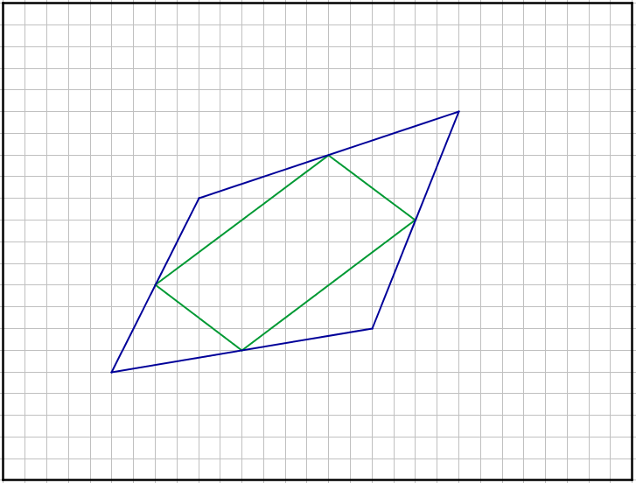
A

Slide 4
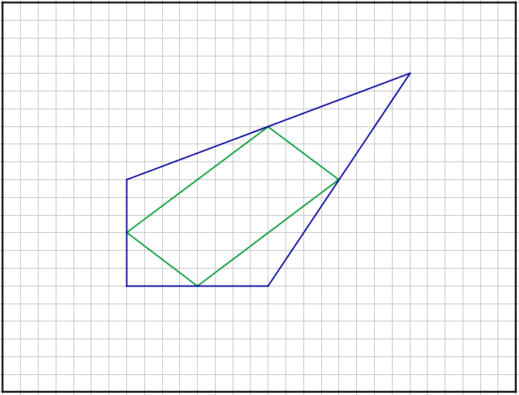
B

Slide 5
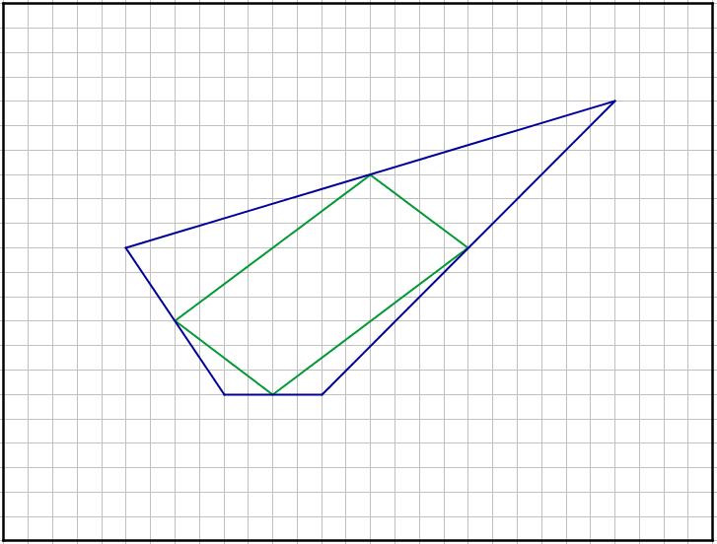
C

Slide 6
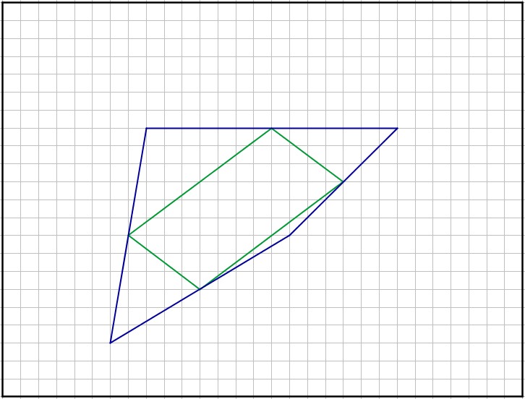
D

Slide 7
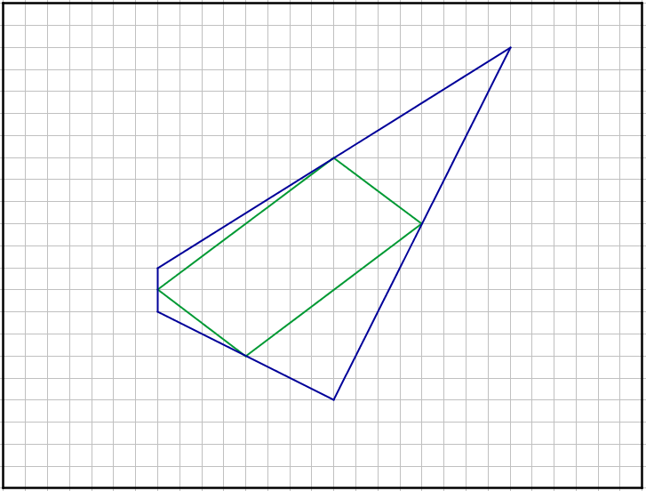
E

Slide 8
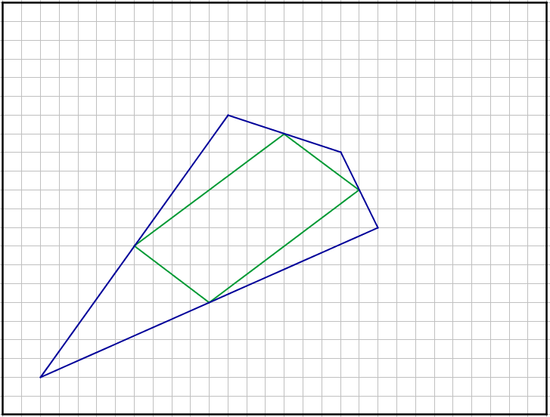
F

Slide 9
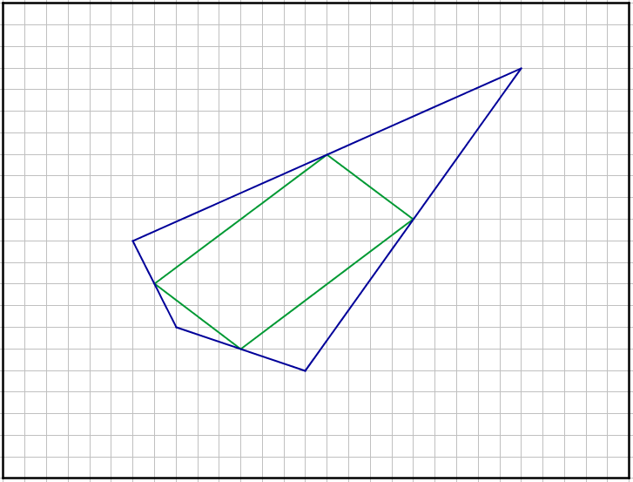
G

Slide 10
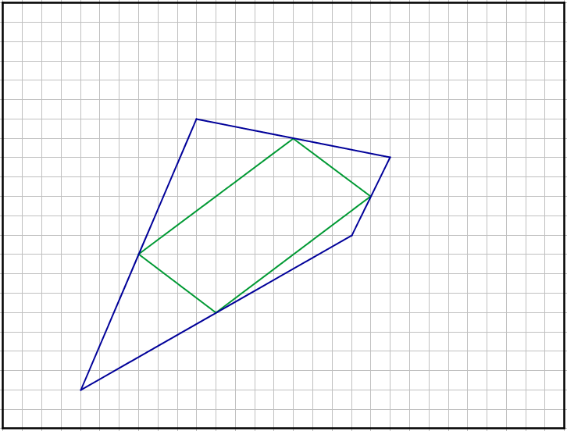
H

Slide 11
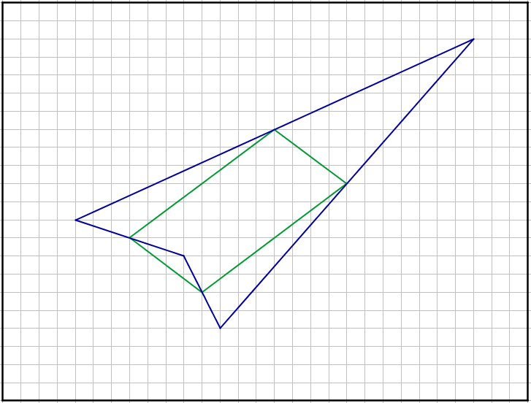
I

Slide 12
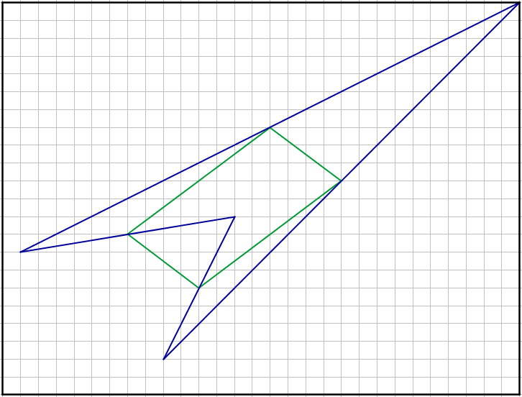
J

Slide 13
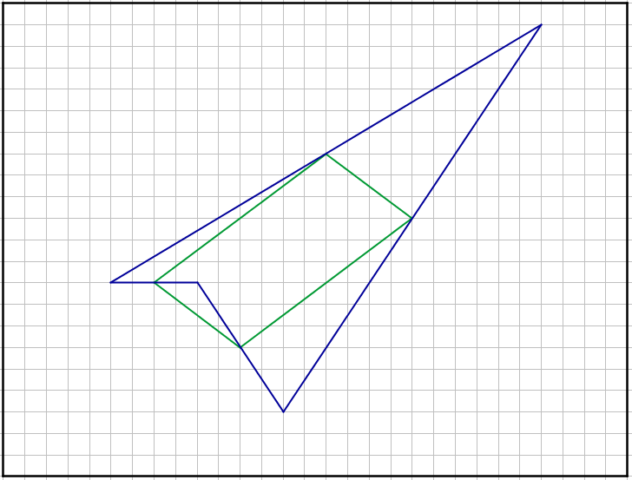
K

Slide 14
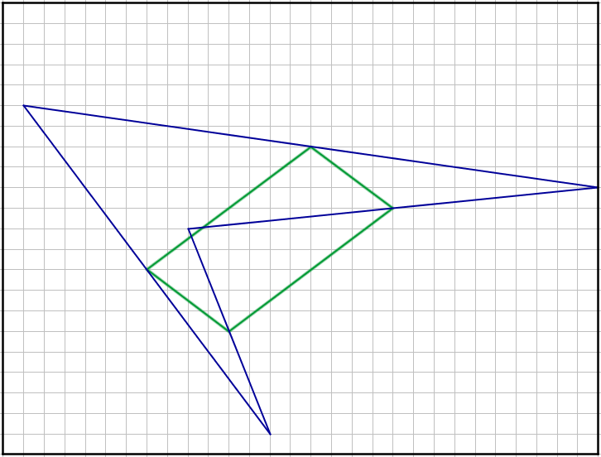
L

Slide 15
All of the quadrilaterals are different in shape…
But all of the parallelograms are identical!
Can you explain this?
All of the quadrilaterals are similar in some respects. Which respects?
The midpoints of each side are coincident
They all have the same area
Can you prove why the area is the same?

Slide 16
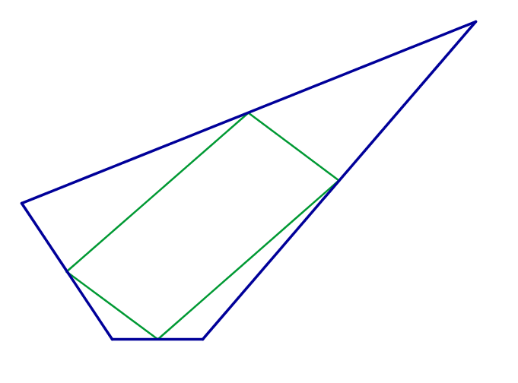




What is the area of the parallelogram compared to the area of the enveloping quadrilateral?
$$B$$
$$C$$
$$O$$
$$A$$

Slide 17
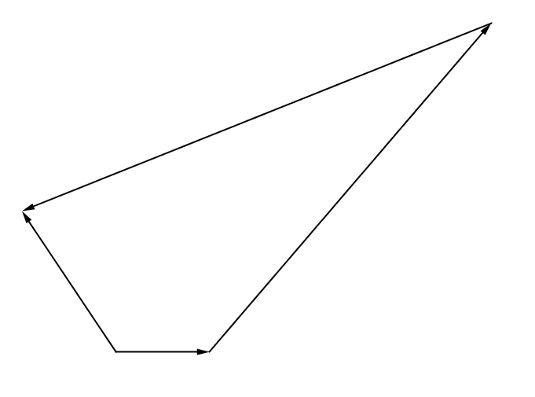




$$B$$
$$\underline{c}$$
$$C$$
$$\underline{b}$$
$\underline{a}$+$\underline{b}$+$\underline{c}$
$$O$$
$$\underline{a}$$
$$A$$

Slide 18
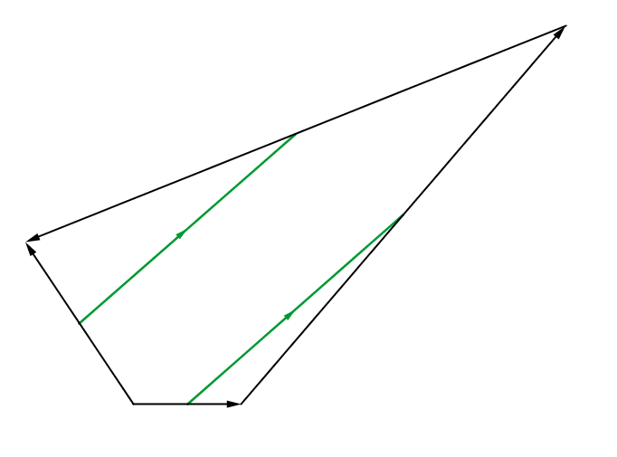


$$B$$
$$\underline{c}$$
$$\frac{1}{2}\left(\underline{a}+\underline{b}\right)$$
$$C$$
$$\underline{b}$$
$\underline{a}$+$\underline{b}$+$\underline{c}$
$$\frac{1}{2}\left(\underline{a}+\underline{b}\right)$$
$$O$$
$$\underline{a}$$
$$A$$

Slide 19
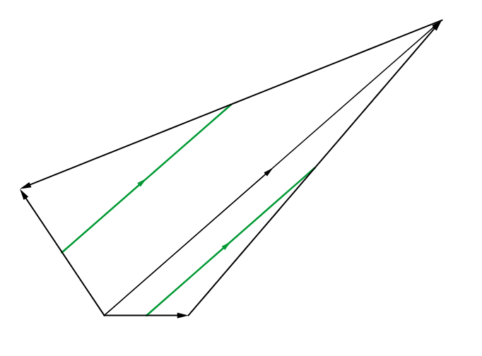

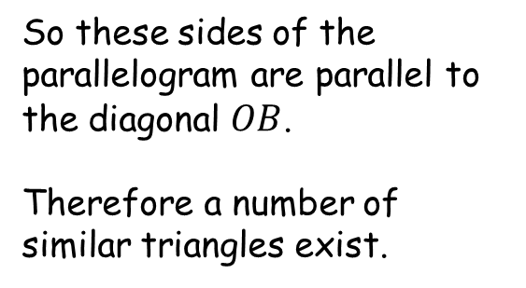
$$B$$
$$\frac{1}{2}\left(\underline{a}+\underline{b}\right)$$
$$C$$
$$\left(\underline{a}+\underline{b}\right)$$
So these sides of the parallelogram are parallel to the diagonal $OB$.
Therefore a number of similar triangles exist.
$$\frac{1}{2}\left(\underline{a}+\underline{b}\right)$$
$$O$$
$$A$$

Slide 20
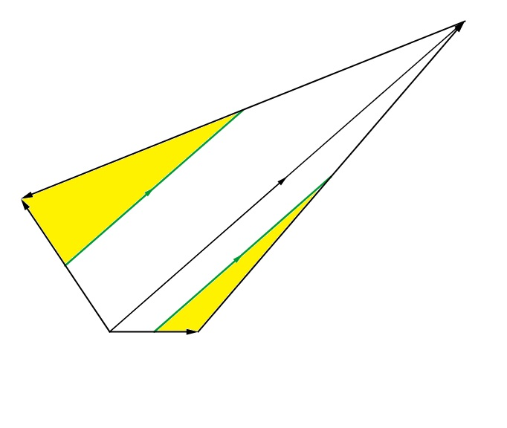

$$B$$
$$C$$
Each yellow triangle is similar to the larger triangle in which it sits and has a scale factor of $\frac{1}{2}$ .
Therefore the yellow triangles represent $\frac{1}{4}$ of the area of the quadrilateral.
$$O$$
$$A$$

Slide 21
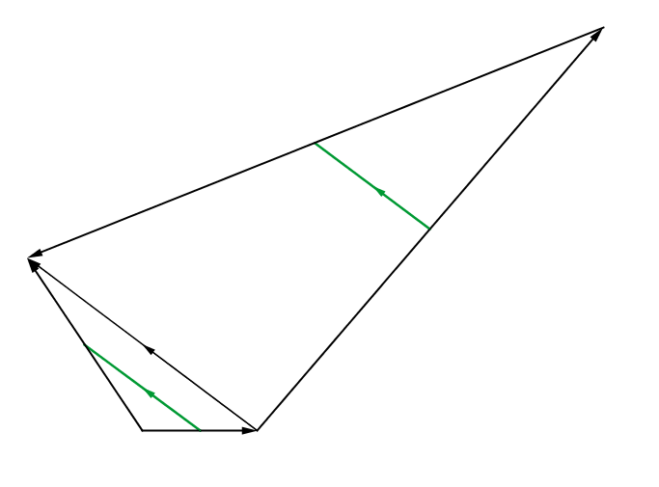



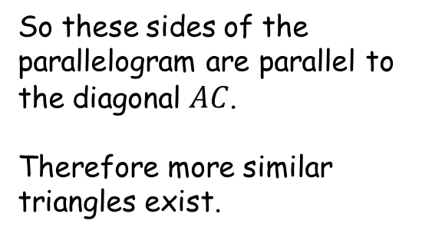
$$B$$
$$\underline{c}$$
$$\frac{1}{2}\left(\underline{b}+\underline{c}\right)$$
$$C$$
$$\underline{b}$$
So these sides of the parallelogram are parallel to the diagonal $AC$.
Therefore more similar triangles exist.
$$\left(\underline{b}+\underline{c}\right)$$
$\underline{a}$+$\underline{b}$+$\underline{c}$
$$\frac{1}{2}\left(\underline{b}+\underline{c}\right)$$
$$O$$
$$\underline{a}$$
$$A$$

Slide 22
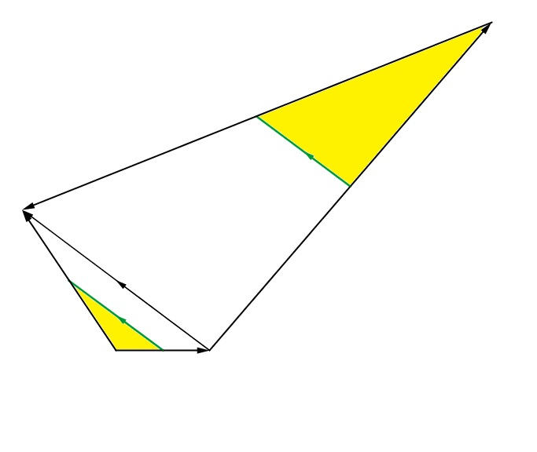

$$B$$
$$C$$
Again, each yellow triangle is similar to the larger triangle in which it sits sits and has a scale factor of $\frac{1}{2}$ .
Therefore the yellow triangles represent $\frac{1}{4}$ of the area of the quadrilateral.
$$O$$
$$A$$

Slide 23
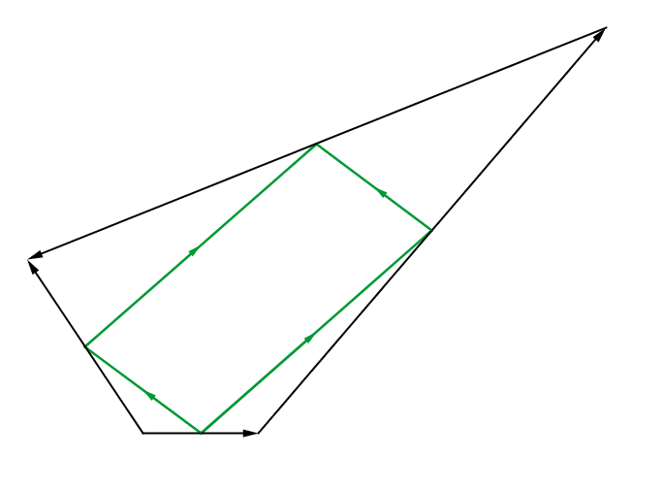
$$B$$
$$C$$
$$O$$
$$A$$

Slide 24
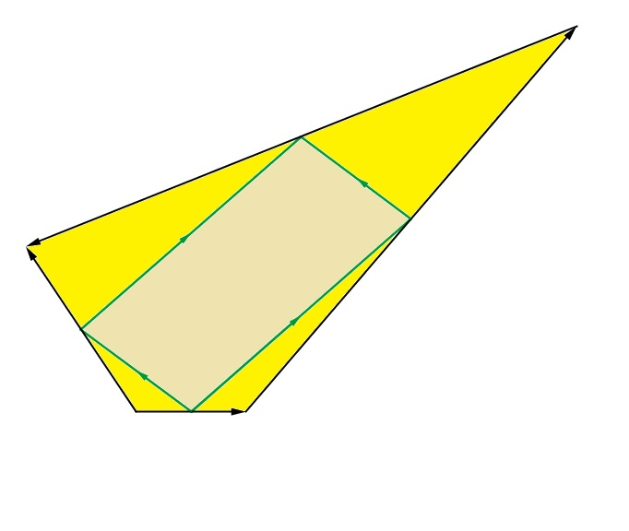

$$B$$
$$C$$
The yellow triangles represent $\frac{1}{2}$ of the area of the quadrilateral.
Therefore the parallelogram must also represent $\frac{1}{2}$ of the area of the quadrilateral.
$$O$$
$$A$$

Slide 26
Resources
Without grid

Slide 27
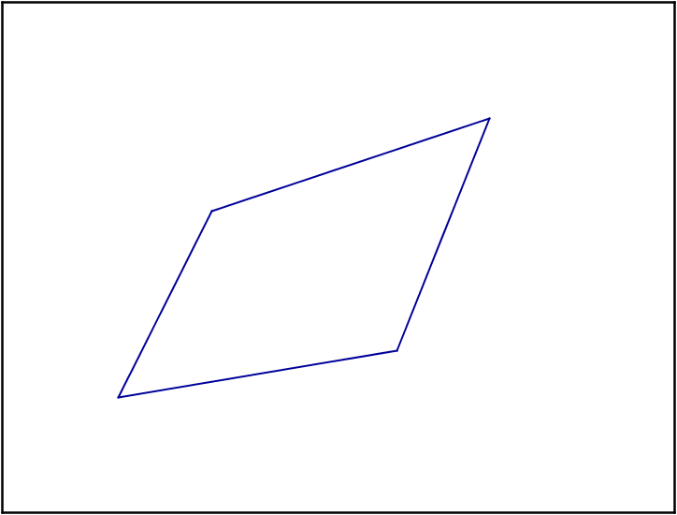
A
SIC_4

Slide 28
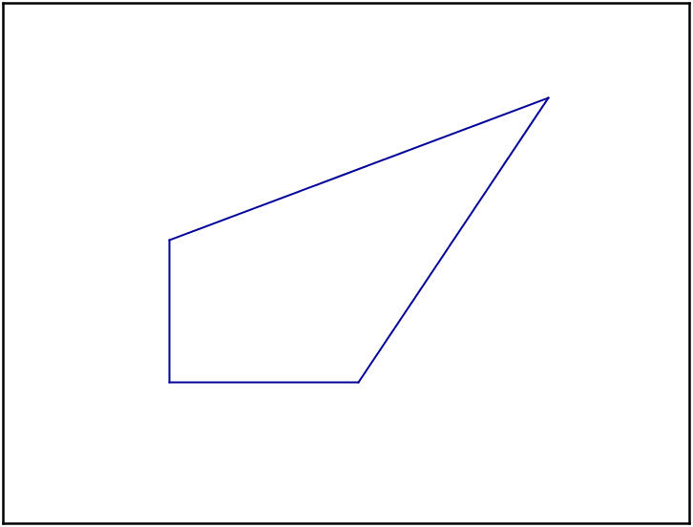
B
SIC_4

Slide 29
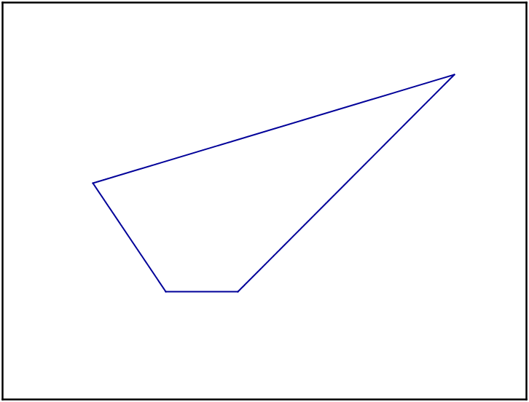
C
SIC_4

Slide 30
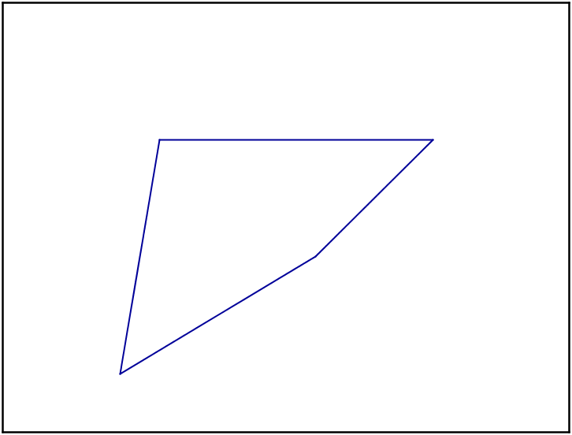
D
SIC_4

Slide 31
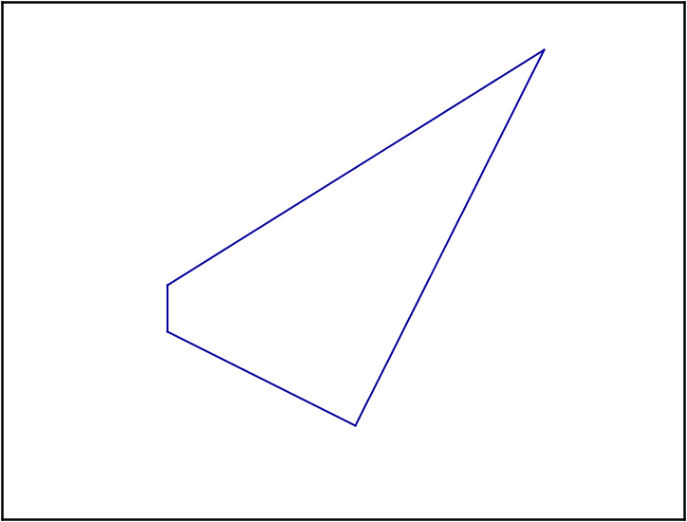
E
SIC_4

Slide 32
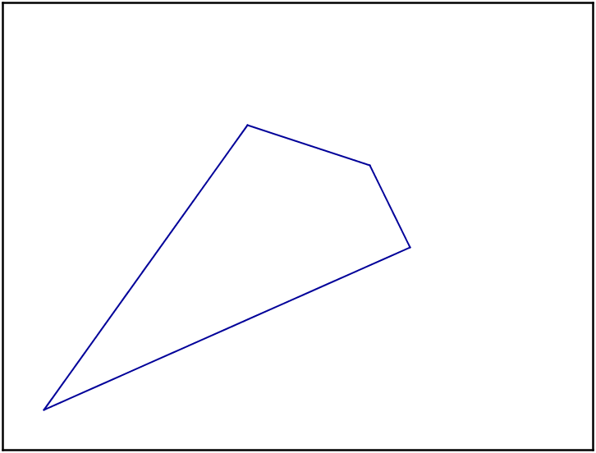
F
SIC_4

Slide 33
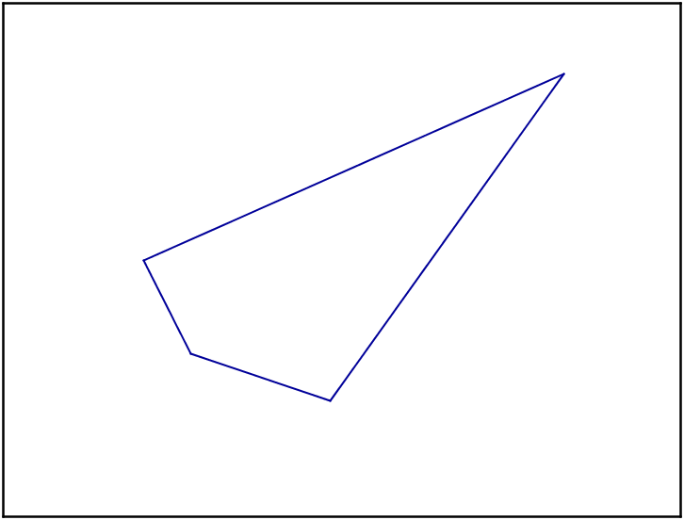
G
SIC_4

Slide 34
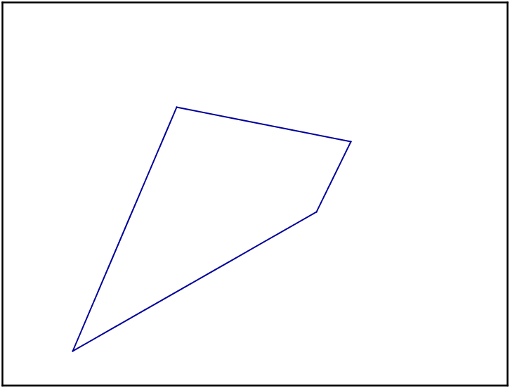
H
SIC_4

Slide 35
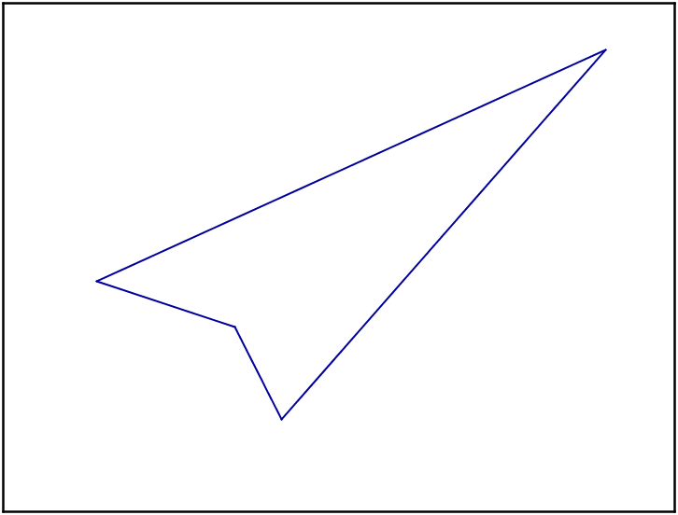
I
SIC_4

Slide 36
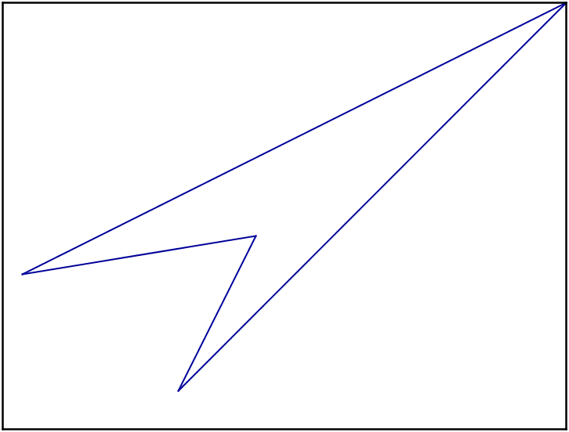
J
SIC_4

Slide 37
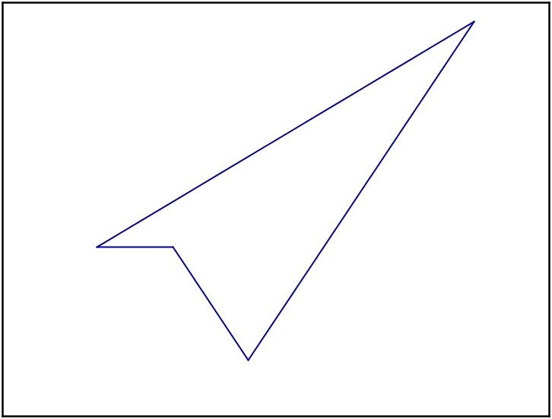
K
SIC_4

Slide 38
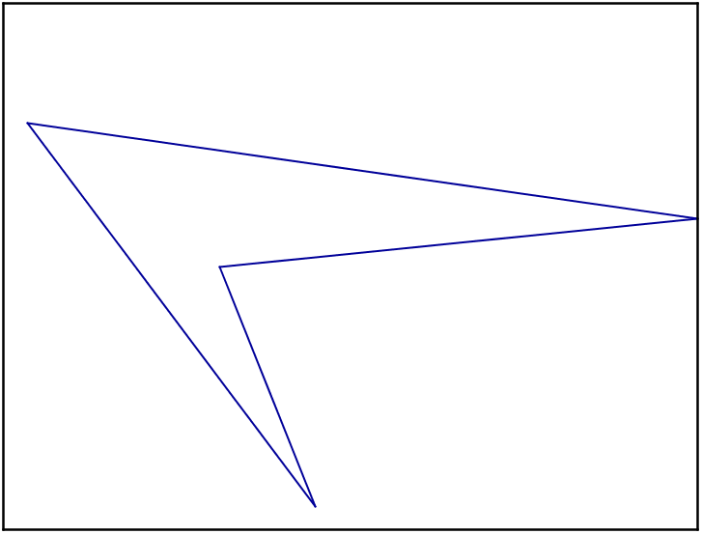
L
SIC_4

